Slide 1
Route Recommender
by Jordi Zaragoza

Slide 2
Introduction
What is sports climbing
Why a route recommender
How I created it

Slide 3
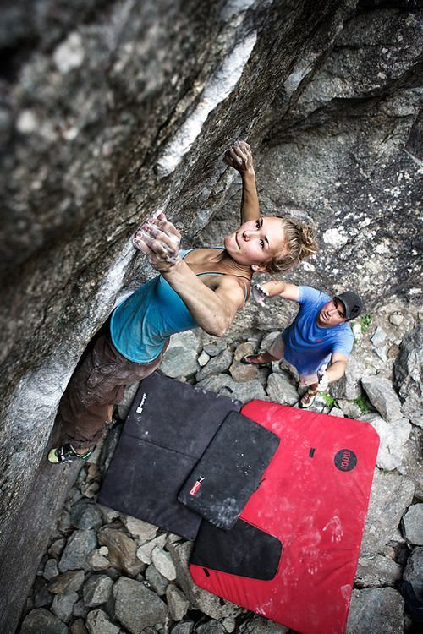
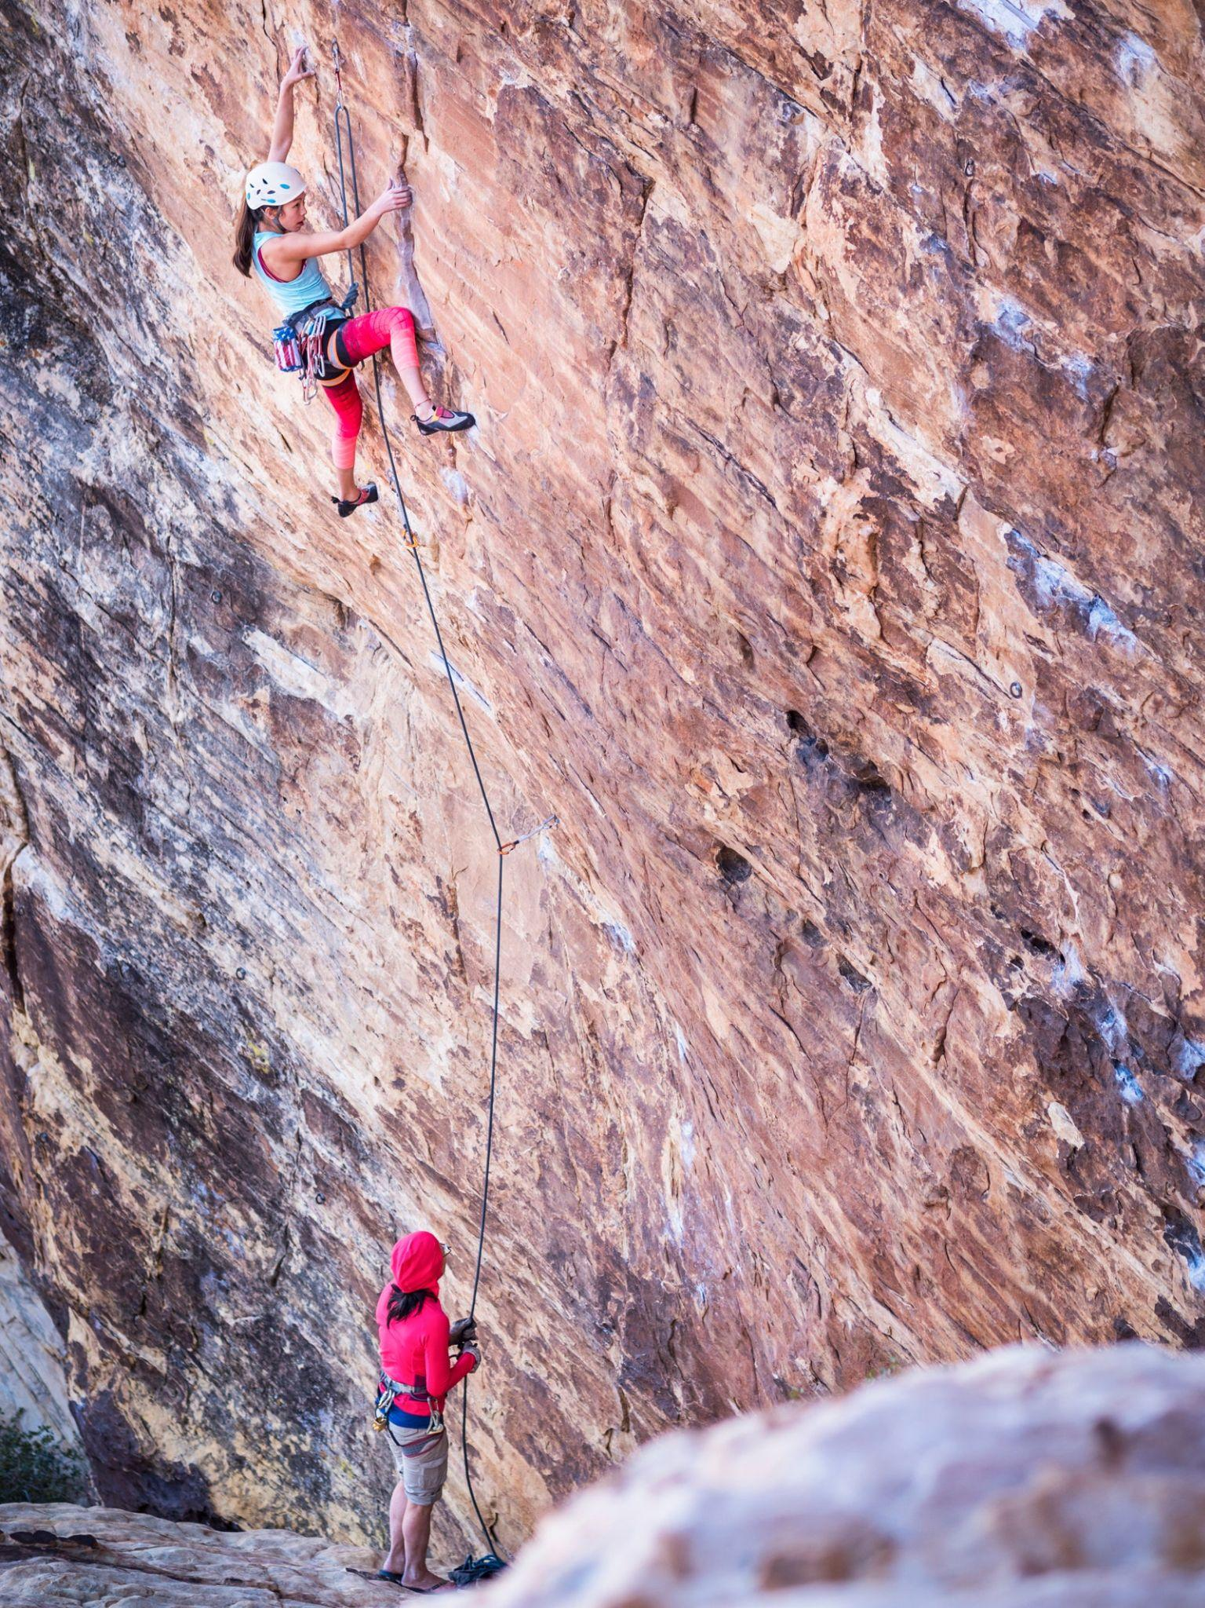
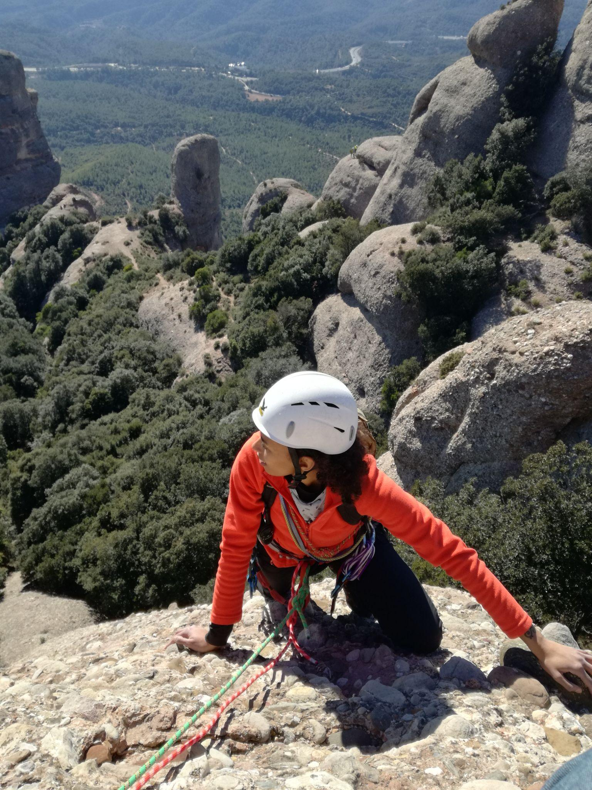
What is sports climbing
Boulder
Sports Climbing
Traditional

Slide 4
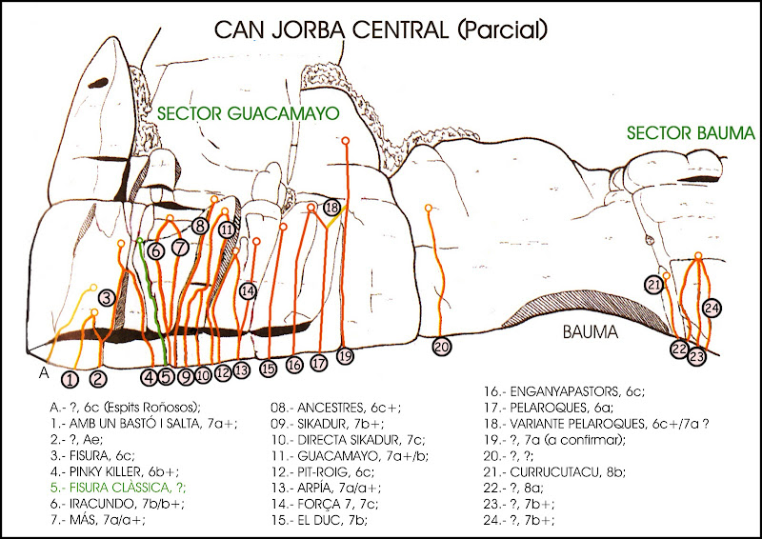
Why a route recommender
Grading (difficulty)
Traditional/Modern
Famous routes
Powerful/Endurance
Nice/Ugly routes
Hard/Easy for the grade

Slide 5
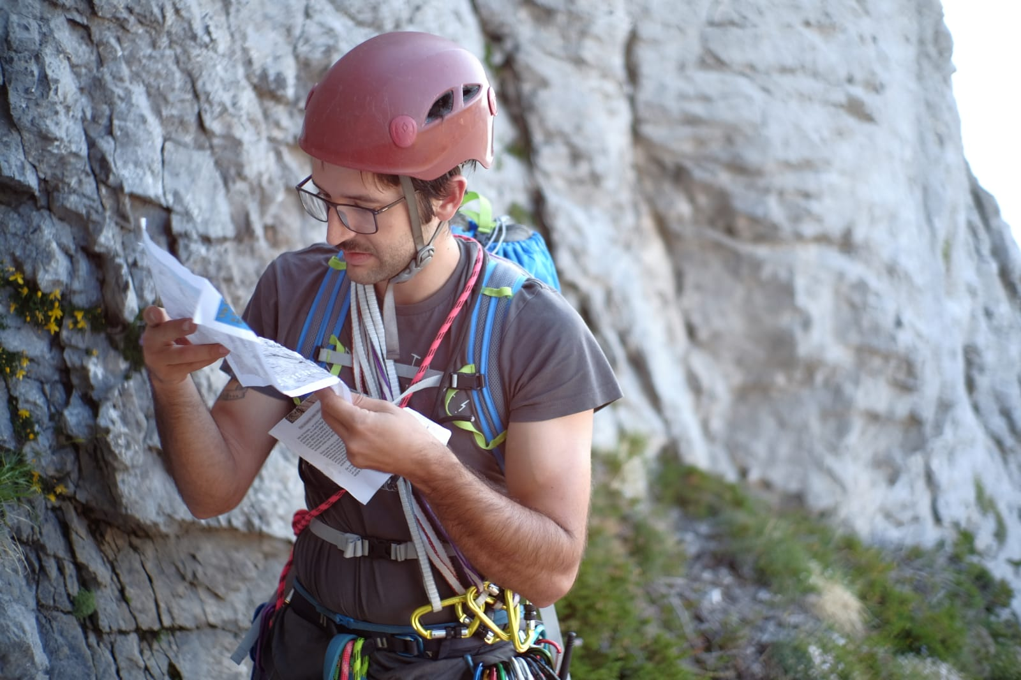
Why a route recommender
????

Slide 6
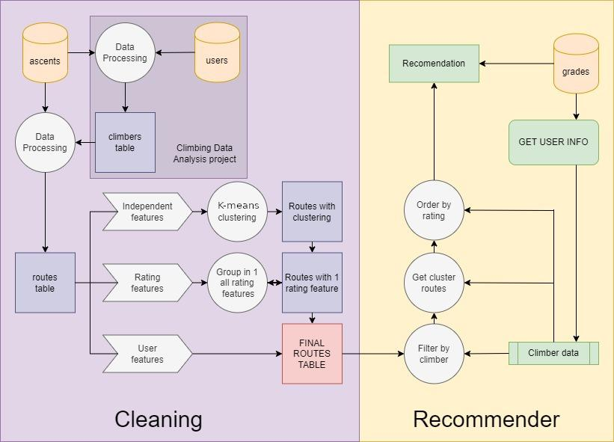
How I created it
Obtaining routes table
Modelling features
Recommender

Slide 7
Obtaining routes table
Created text_processor_class:
Cleaning
NLP for Similarity
NLP for Sentiment
NLP for Language check
1

Slide 8
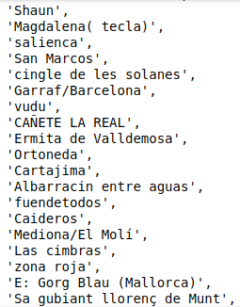
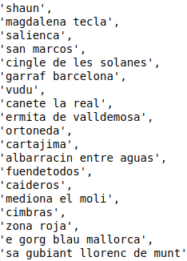
1.1 Cleaning
For example: climbing sector names:

Slide 9
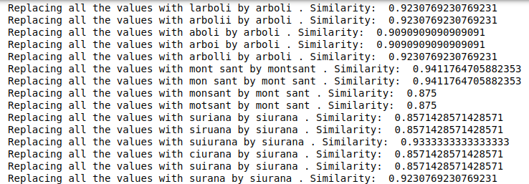
1.2 Replacing
Using NLP for similarity check

Slide 10
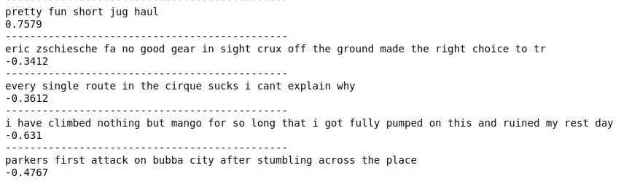
1.3 Sentiment
Using NLP for sentiment on comments

Slide 11
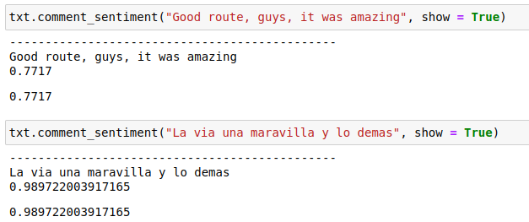
1.4 Language check
Using Language check + sentiment (English and Spanish)

Slide 12
2. Modelling features
Independent features
Rating features
User features
2

Slide 13
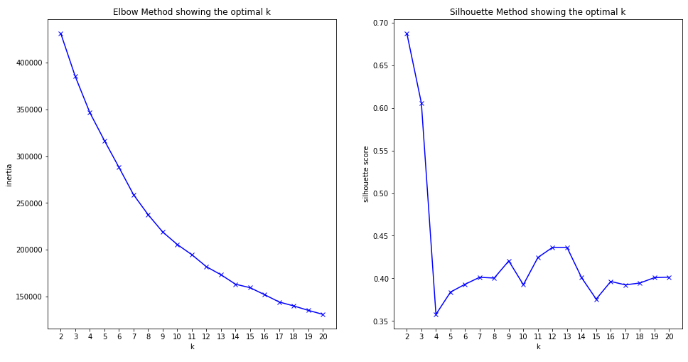
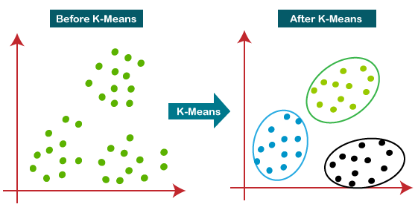
2.1 Independent features
Repeated, famous, traditional, hard, chipped…
K-Means clustering

Slide 14
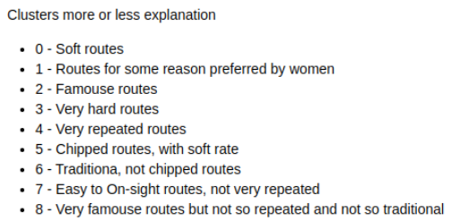
2.1 Independent features
K-Means clustering: 9 clusters

Slide 15
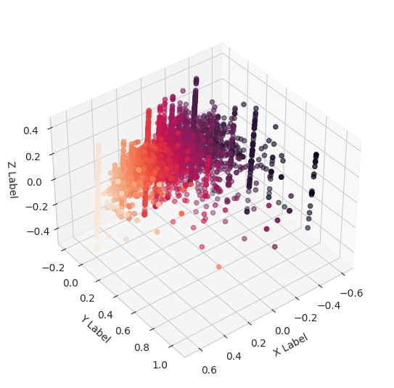
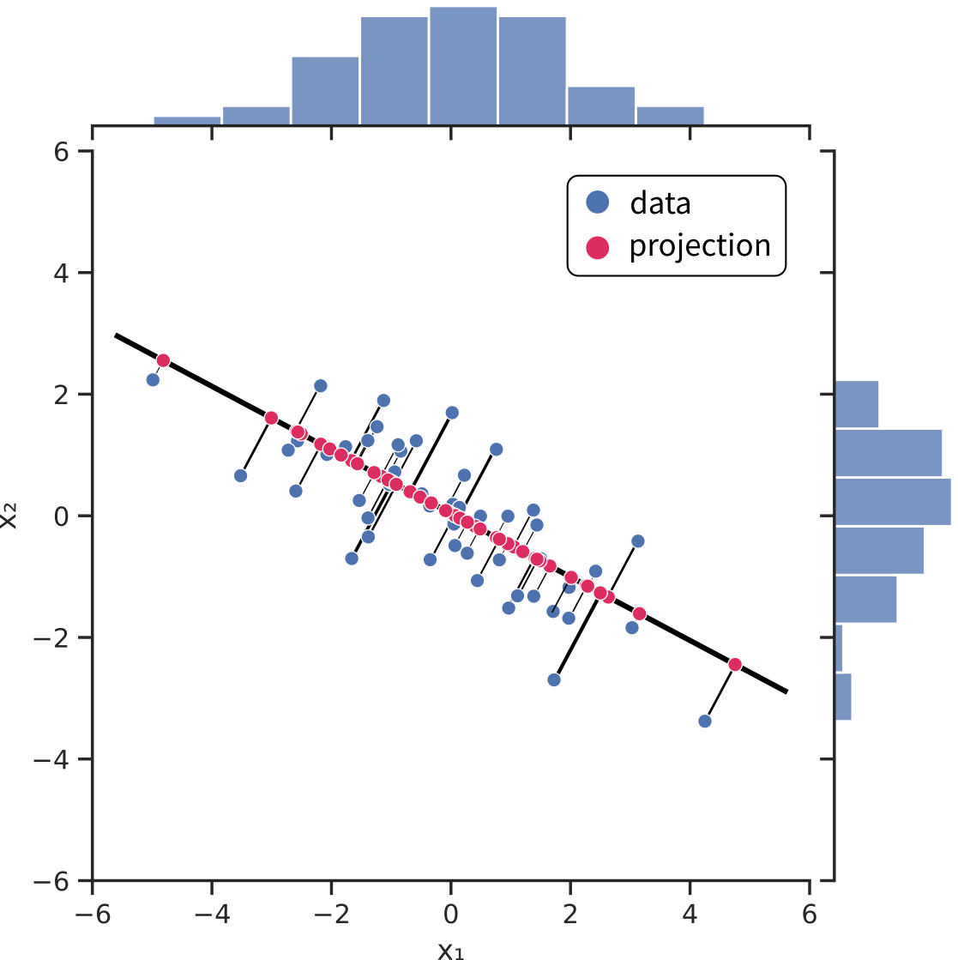
2.2 Rating features
Sentiment, Rating, Recommended
Dimensionality reduction (PCA)
Ordering routes
PCA

Slide 16
3. Recommender
3
User introduces his/her their info
Recommender filters
Assigns a Cluster
Order by rating
Created an App using Streamlit
Deployed in Heroku

Slide 17
Questions?

Slide 19
